Slide 1
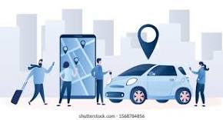

Capstone Project
SHARE RIDE

Slide 2
GROUP – 05 TEAM MEMBERS​
BHAVSAR SIDDESH RAJESH - 52148540
SOMA.PUSHPARAGANJALI - 52146693
T.ROJA ALICE - 52146813
TUMMALA PENTA LASYA VARDHINI - 52146779
YADDULA PAVITRA - 52148336
ANIMELA ANIL KUMAR - 52146895

Slide 3
PROBLEM STATEMENT
Share Ride is a ride sharing website, where we can share rides both on 2 and 4-wheeled vehicles. And to provide user friendly experience with website.

Slide 4
INTRODUCTION
Share Ride is a platform where User and Owner can Register and Login.
Owner can add both two wheeler and four wheeler vehicle.
Owner can add locations and routes.
Owner can create rides.
User can book the vehicle for share or rent.
User and Owner can message to each other.

Slide 5
OBJECTIVES​
OWNER STORY ​
- REGISTER LOGIN ​
- HOME PAGE​
- Vehicle CRUD​
- Ride CRUD
- Routes CRUD
- MESSAGE USER
USER STORY​
- REGISTER LOGIN ​
- HOME PAGE​
- MESSAGE OWNER
- Book Ride
1 Sharing
2 Rent

Slide 6
SOFTWARE REQUIREMENTS
Eclipse : Java Spring Boot Technology​
Vs Code : React JS To Build Front End Part​
Soap Ui/Postman : To test API
MySQL : To store data

Slide 7
SCHEMA/Entity DIAGRAM​

Slide 8
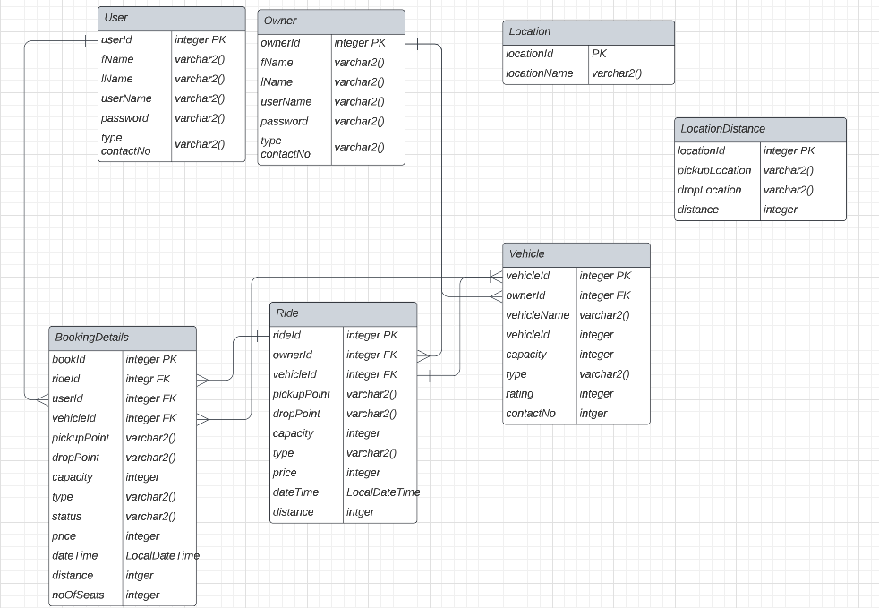

Slide 9
MICROSERVICES
USER MICROSERVICE
OWNER MICROSERVICE
BOOKING MICROSERVICE
MESSAGE MICROSERVICE
EUREKA SERVER MICROSERVICE

Slide 10
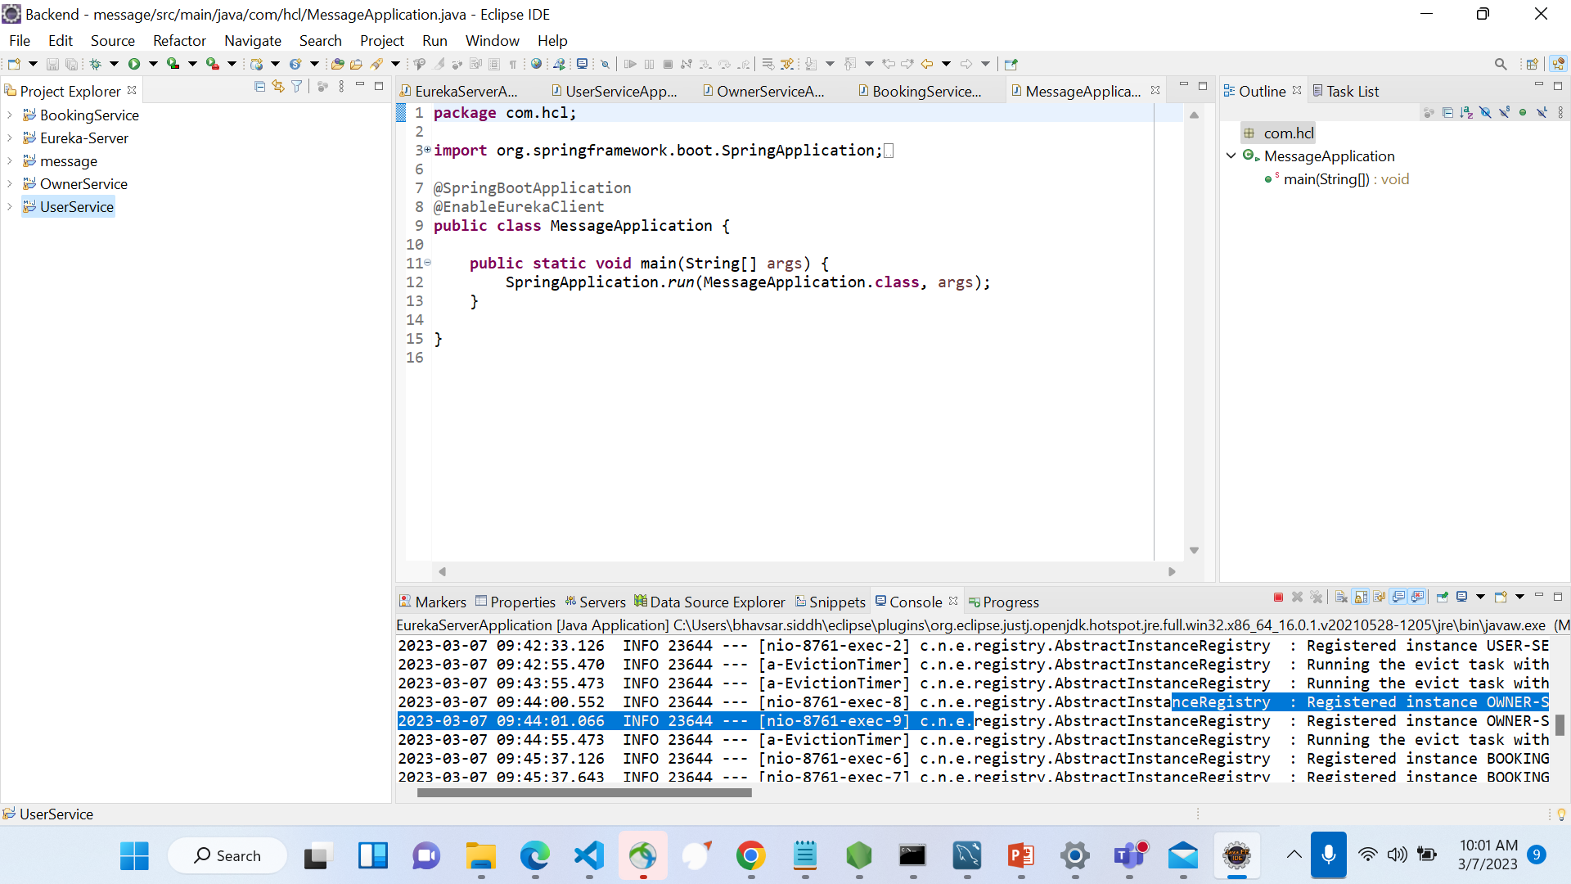
SAMPLE OUTPUT:BACKEND
.

Slide 11
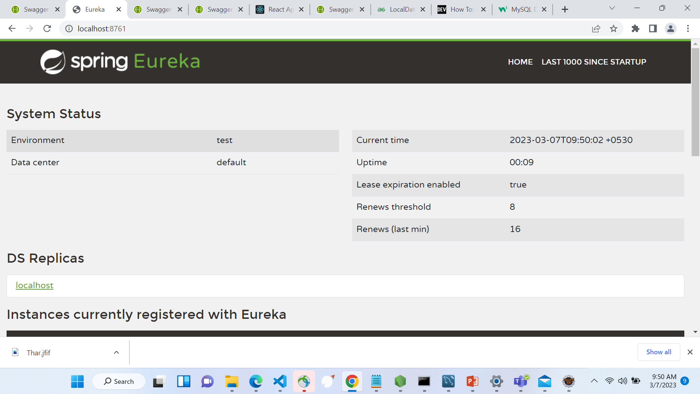
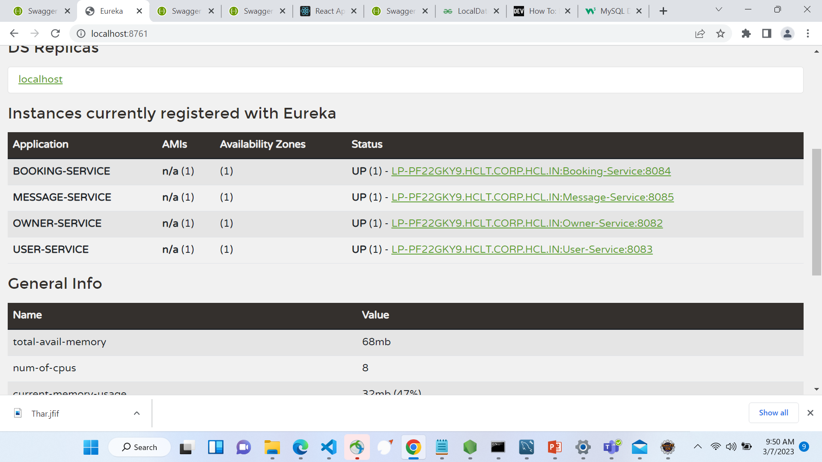
SAMPLE OUTPUT: EUREKA SERVER
.

Slide 12
COMPONENTS
HOME
Login
Register
Contact
About
USER
User home
Choose Ride
Book Ride
Confirm Ride
Booking
Message
OWNER
Owner home
Vehicle CRUD
Ride CRUD
Booking Details
Message

Slide 13
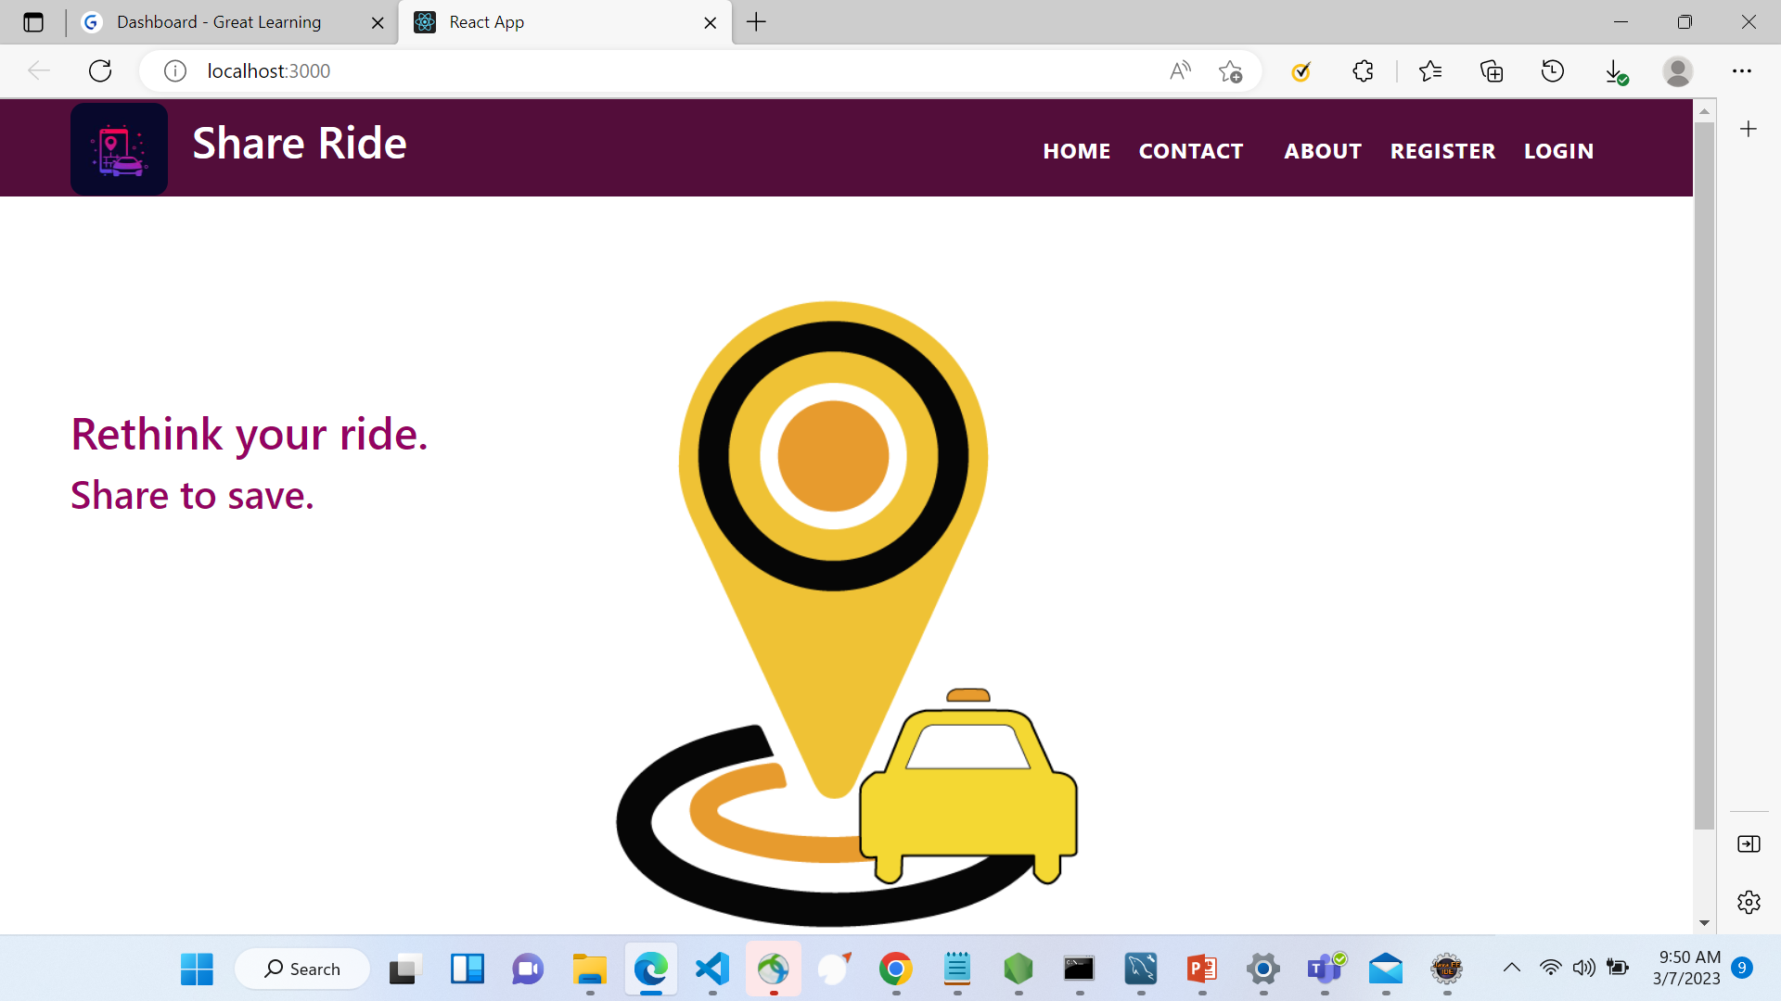
SAMPLE OUTPUT: Main Home Page
.

Slide 14
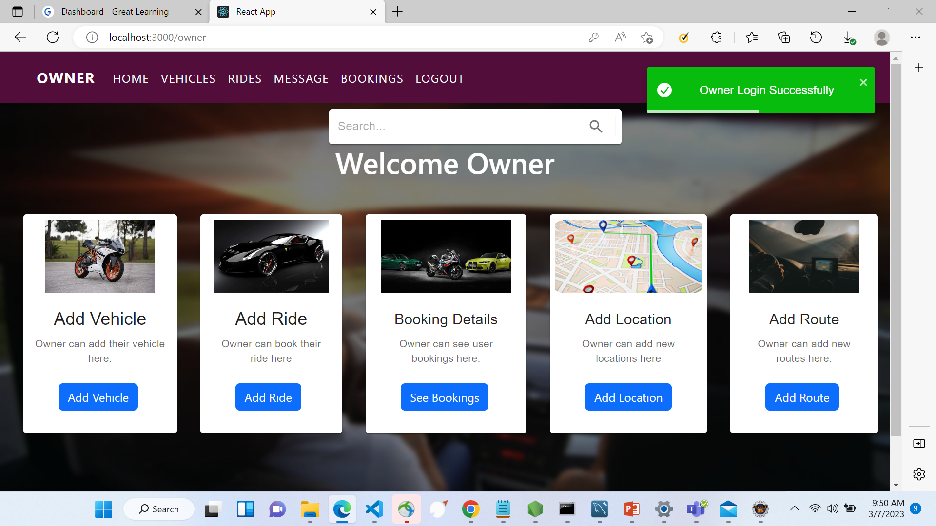
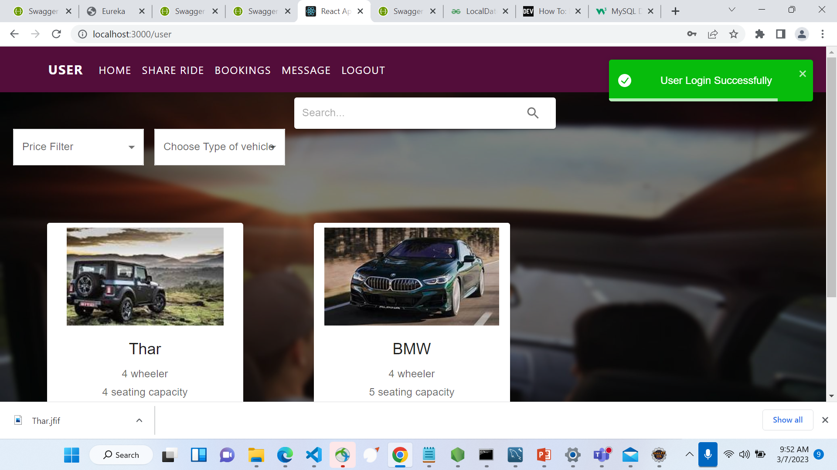
SAMPLE OUTPUT: Owner and User Home page
.

Slide 15
SCHEMA DIAGRAM​ FOR USER

Slide 16
USER BLOCK DIAGRAM
Welcome Page
USER
REGISTER
LOGIN
LOGIN PAGE
HOME PAGE
FIND VEHICLES
BOOKING SERVICE​
MESSAGE OWNER​

Slide 17
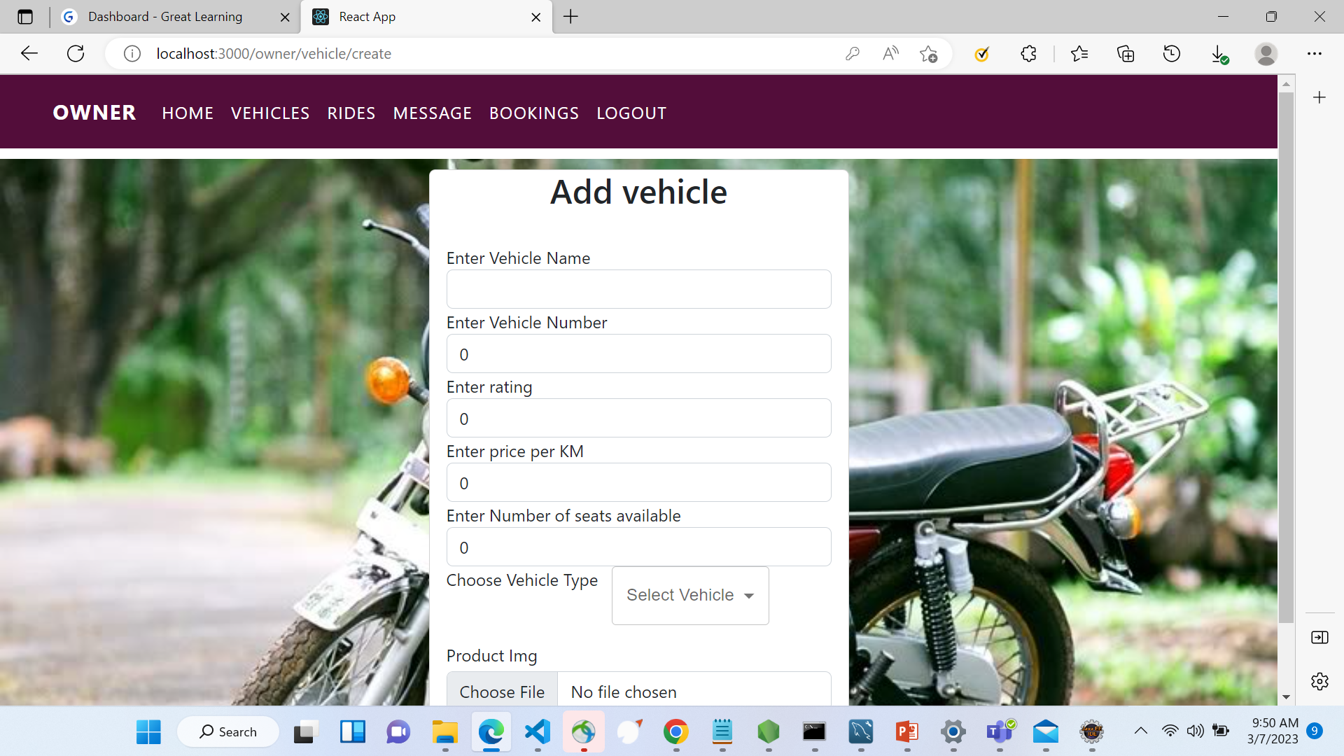
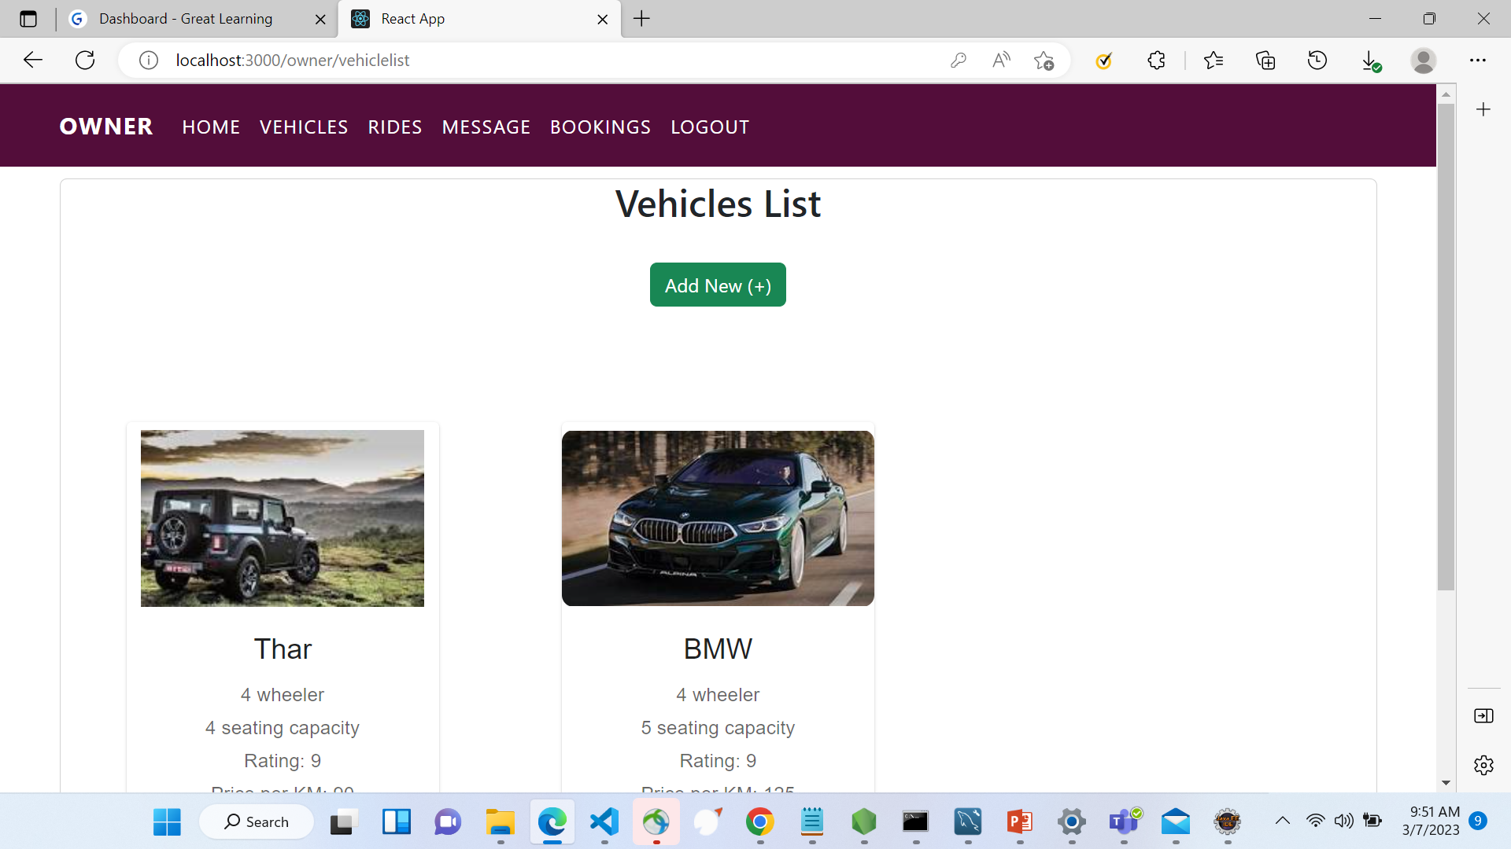
SAMPLE OUTPUT: Vehicle CRUD
.

Slide 18
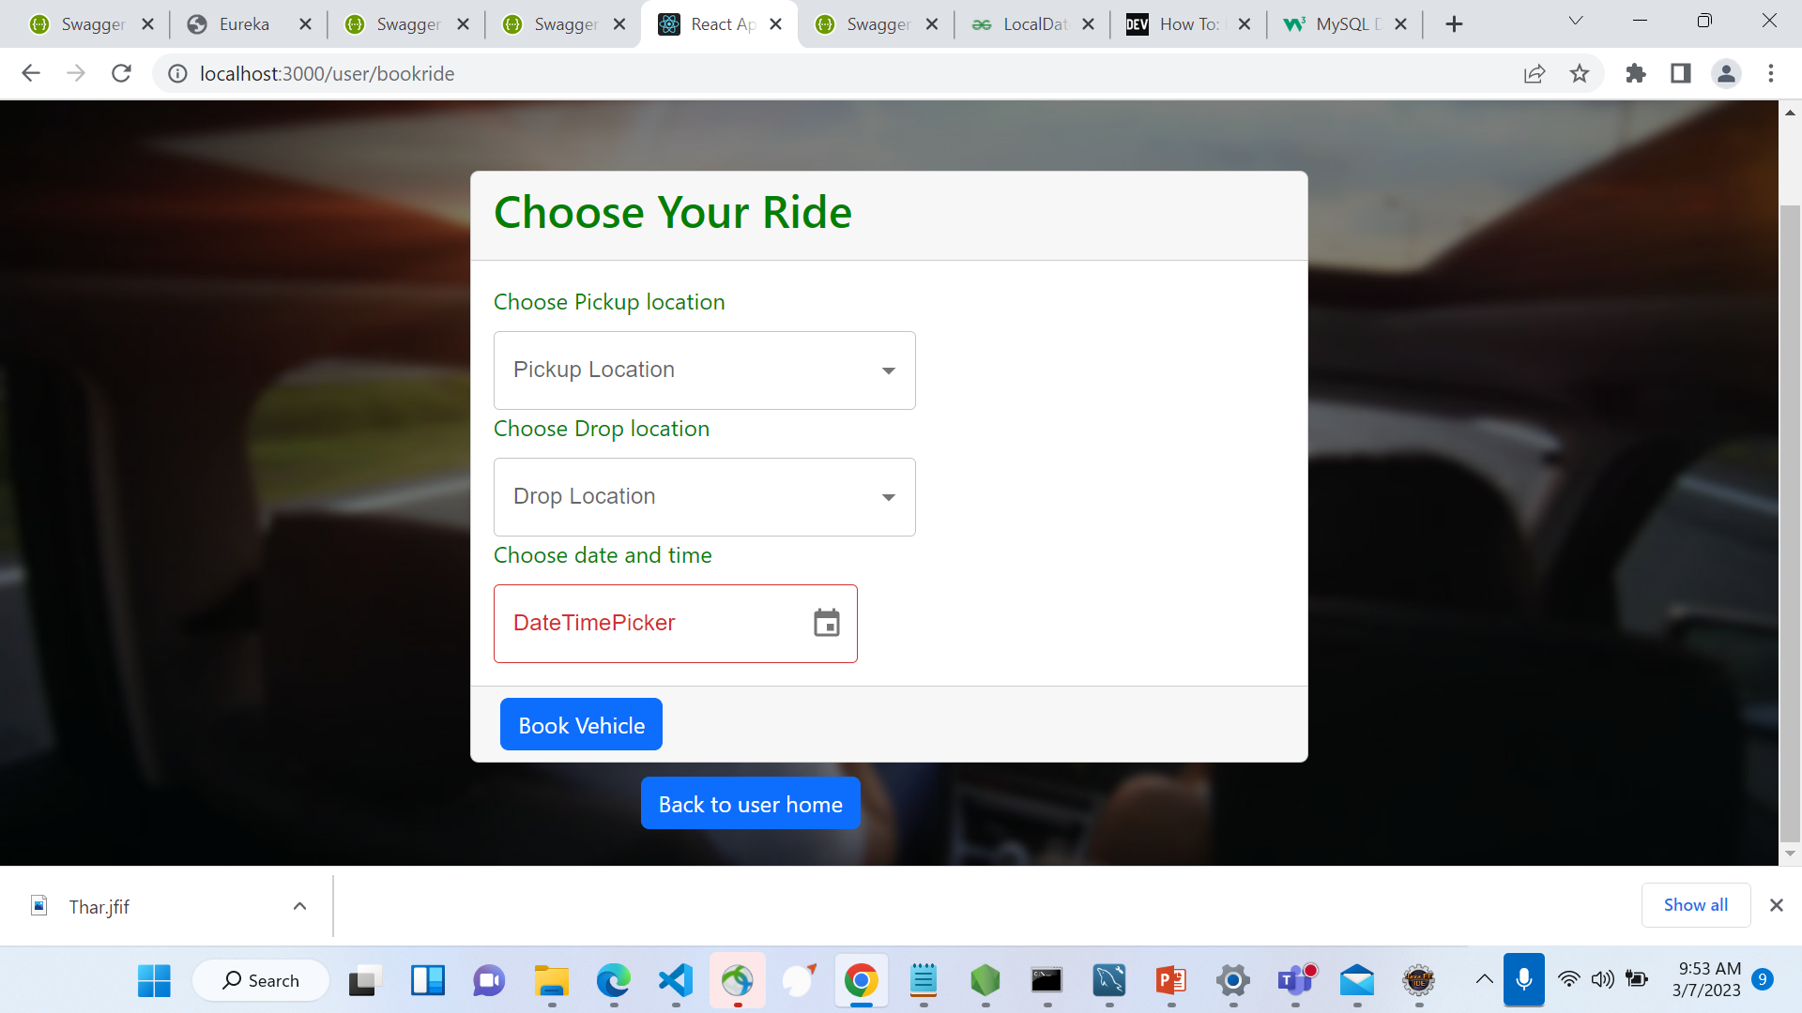
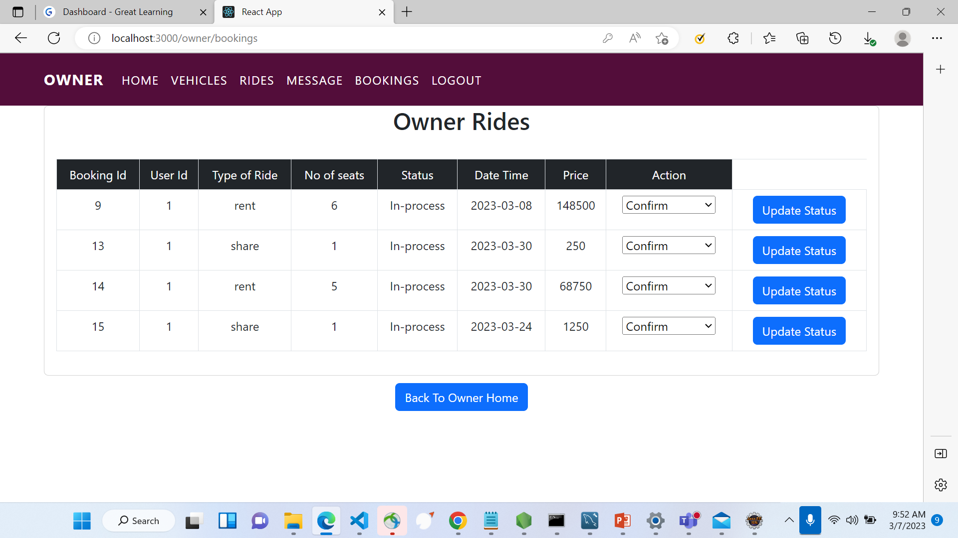
SAMPLE OUTPUT: Ride Details
.

Slide 19
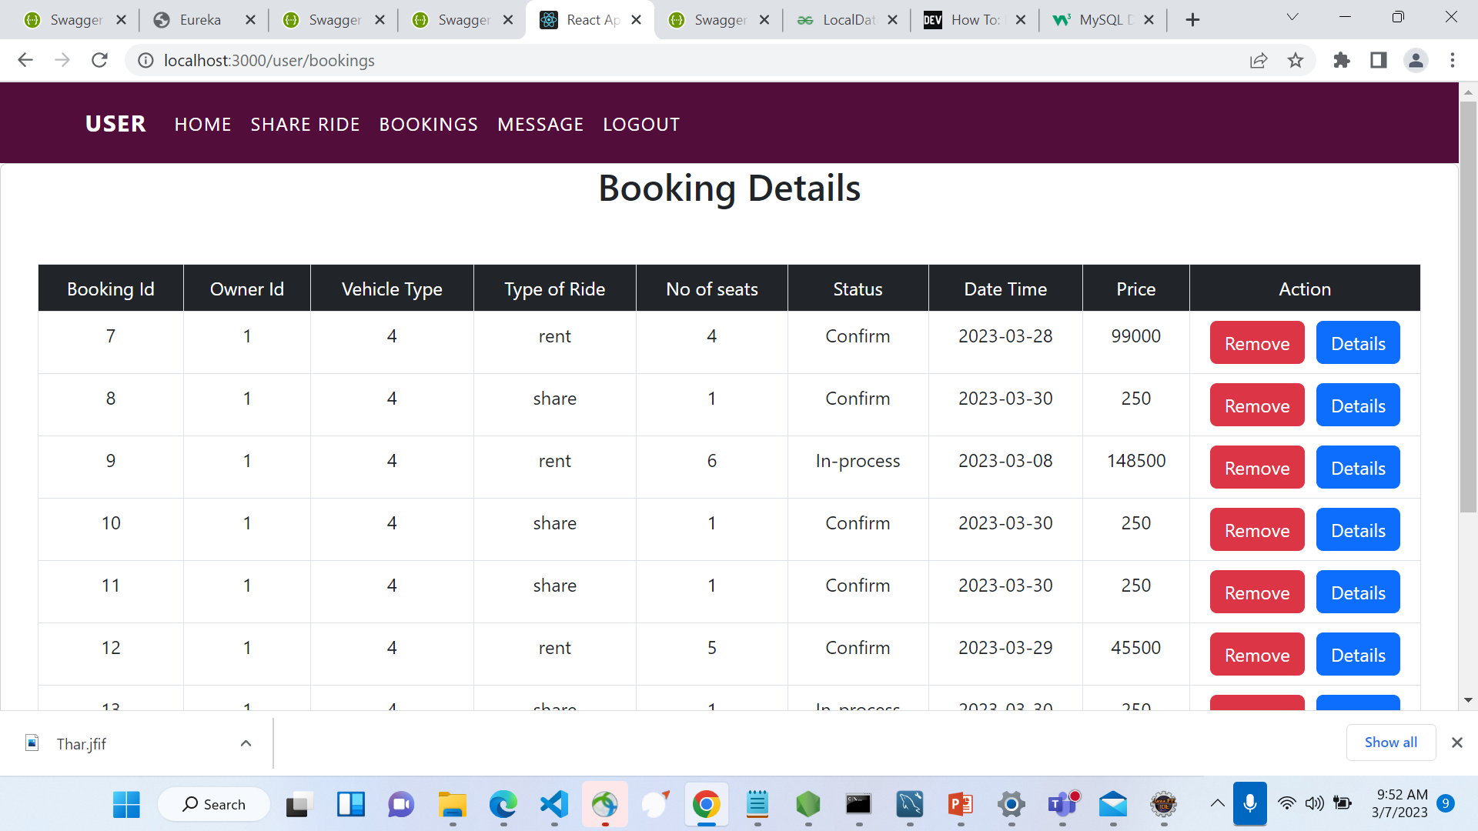
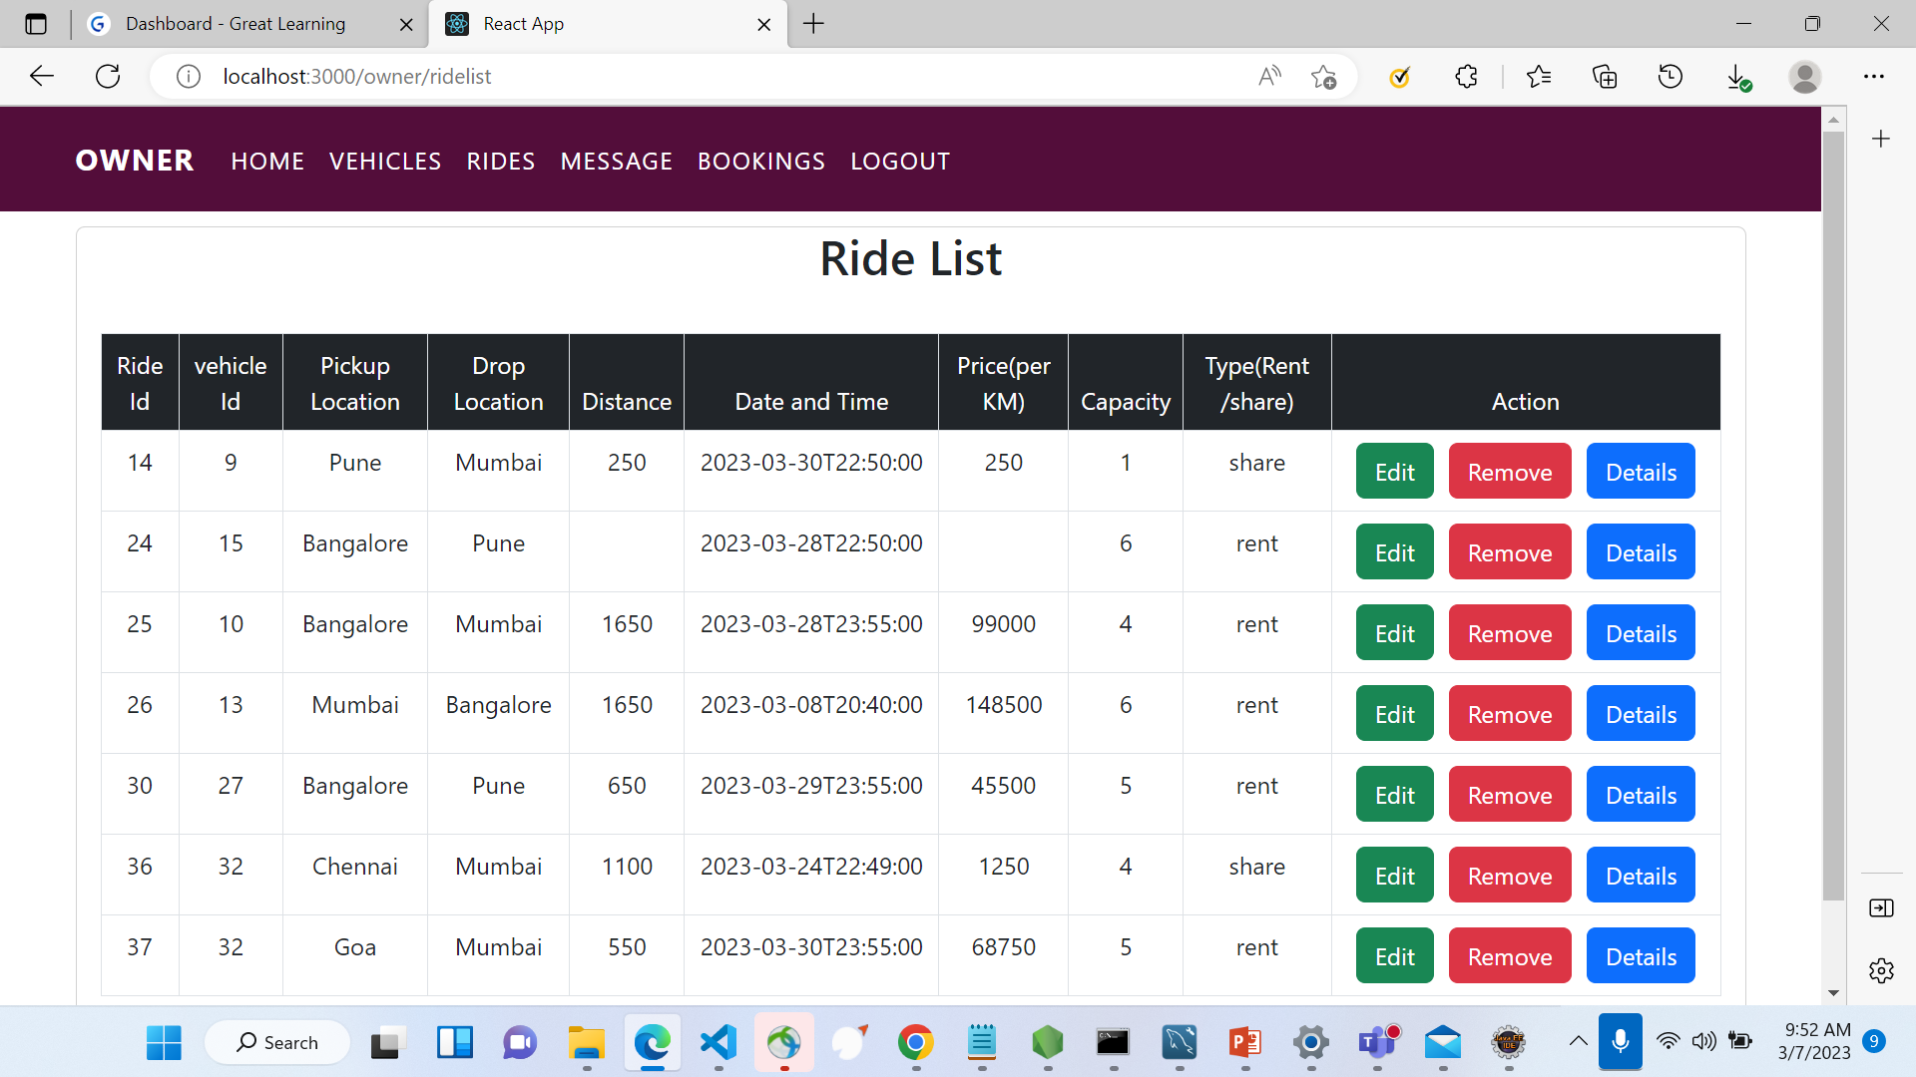
SAMPLE OUTPUT: Booking and Ride List
.

Slide 20
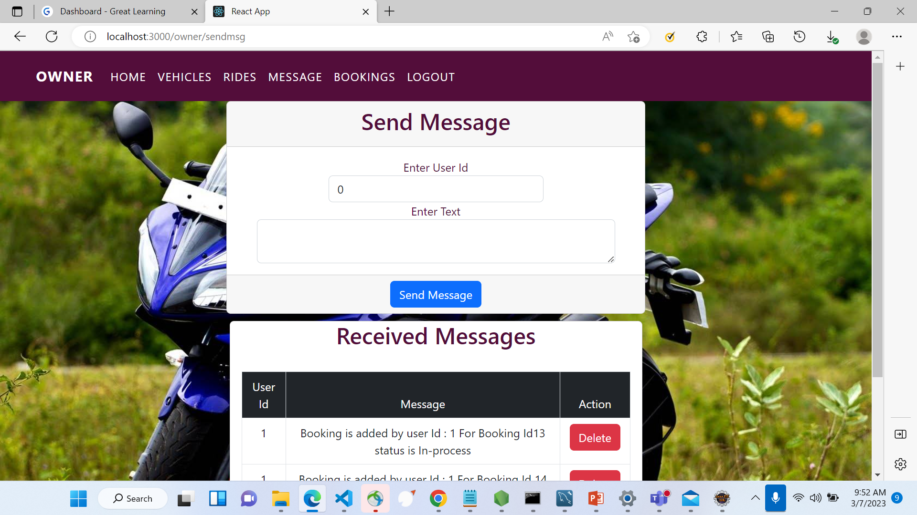
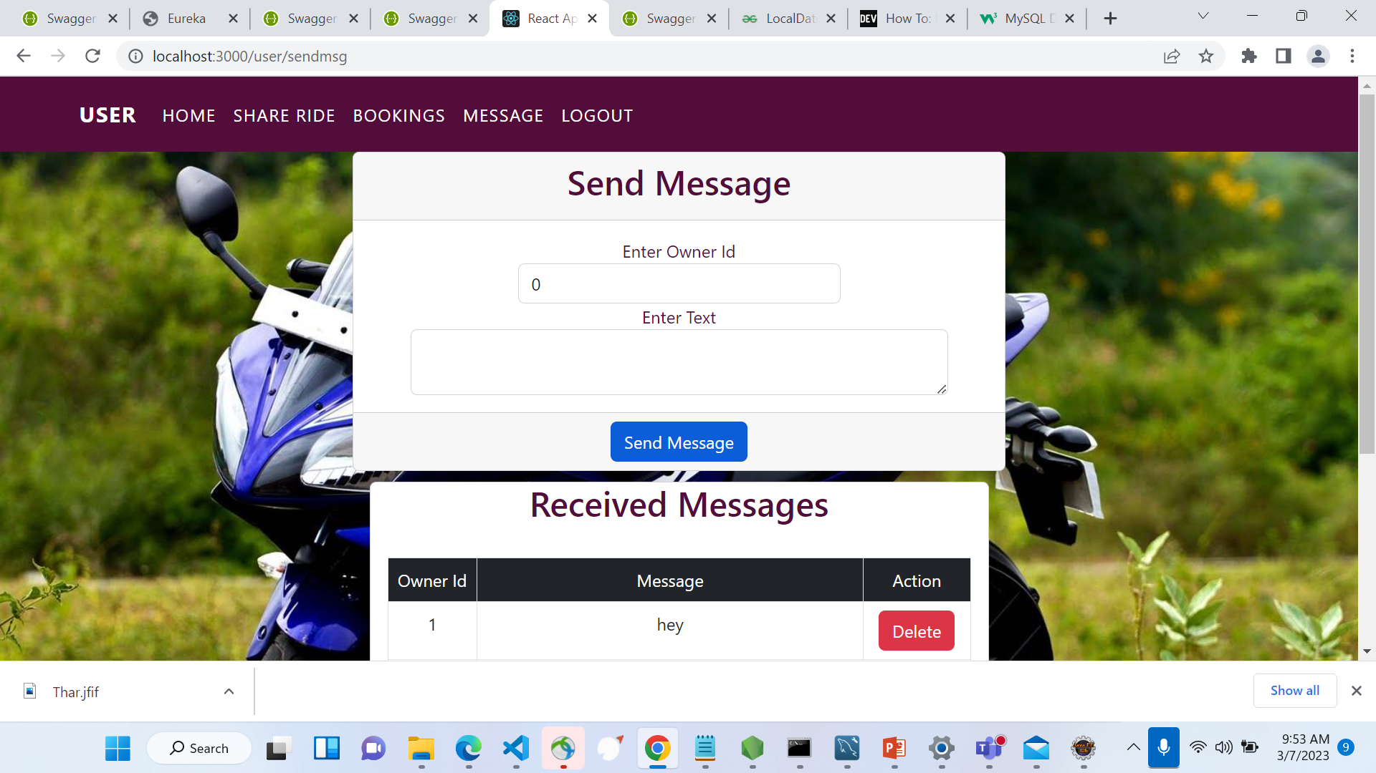
SAMPLE OUTPUT: Message
.

Slide 21
CONCLUSION
Share Ride website helps vehicle owners and users to share and rent the vehicles . If Location and Time matches then they can travel together. Users can save and Owners can earn money respectively.

Slide 22
THANK YOU

